Slide 1


PREPARED BY:
RESPONSIVE FOOD DELIVERY WEBPAGE
NAME: AYUSH SHAH
ENROLLMENT NO: 21002170110167
ROLLNO: 134

Slide 2
INTRODUCTION
Welcome to our food delivery responsive webpage!
Our platform is designed to make it easy and convenient for you to order food from your favorite restaurants and have it delivered right to your doorstep.
Our webpage is fully responsive, which means that it works seamlessly across all devices, including desktops, laptops, tablets, and smartphones.
This allows you to place your order quickly and easily, no matter where you are or what device you're using.
So sit back, relax, and let us take care of your food delivery needs. Thank you for choosing our responsive webpage.

Slide 3
CONSTRUCTION OF WEBPAGE
I have use several tags and classes over here.
Here some of the classes are pre-defined under Bootstrap 4/5 i.e container:flex,btn btn-primary etc.
Classes are user defined used in css styling which help user to interface seamlessly.
Basic html tags are used here.

Slide 4
MERITS OF WEBPAGE
Convenience:Customers can easily access the webpage from any device
Easy to Use:The interface is user-friendly and intuitive, making it easy for customers to navigate.
Accessibility:By having a responsive webpage, customers can access the food delivery service from any device they have on hand
Customization:customers can customize their orders to suit their preferences.
Payment Security:A food delivery responsive webpage typically offers secure payment options, which means customers can rest assured that their financial information is protected.

Slide 5
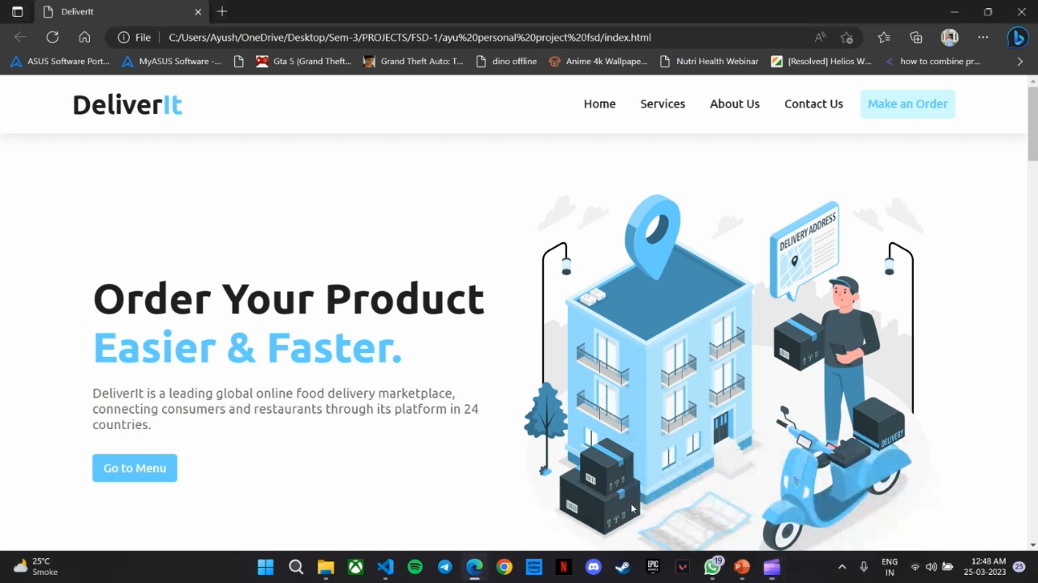
OUTPUT OF CODE:

Slide 6
THANK YOU!

